Slide 1



HR Employee Report
View in Power BI
Last data refresh:
5/22/2023 4:51:30 AM UTC
Downloaded at:
5/22/2023 4:55:02 AM UTC

Slide 2
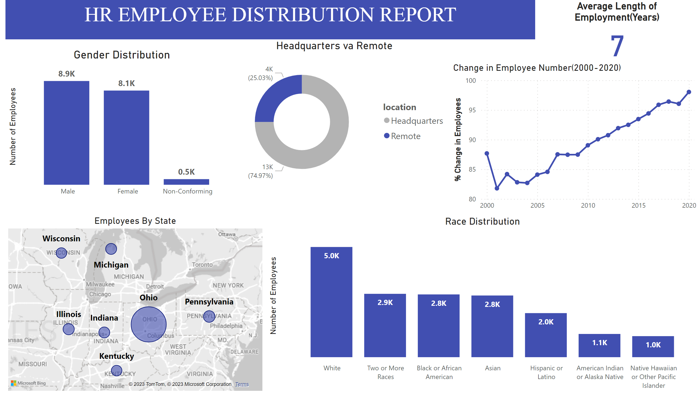
Page 1
Notes:
textbox
No alt text provided
Average Length of Employment(Years)
No alt text provided
Gender Distribution
No alt text provided
Headquarters va Remote
No alt text provided
Change in Employee Number(2000-2020)
No alt text provided
Employees By State
No alt text provided
Race Distribution
No alt text provided

Slide 3
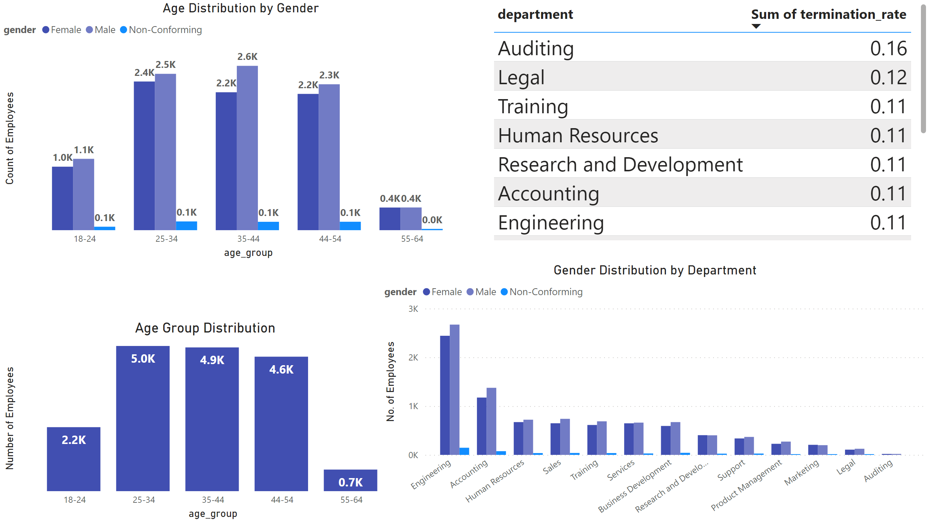
Page 2
Notes:
Age Group Distribution
No alt text provided
Age Distribution by Gender
No alt text provided
tableEx
No alt text provided
Gender Distribution by Department
No alt text provided

